Slide 1
INTRODUCTION TO TEACHING IN FURTHER EDUCATION
Preparing to Teach in the Lifelong Learning Sector

Slide 2
What is the Teacher Training Academy (TTA)?
The TTA has been set up to serve local Portsmouth people who want a change of career
It is run by a company called Newbubbles Ltd, a specialist training & consultancy company based in Portsmouth, formed in 2010.
We are a public limited company, VAT registered and an approved NCFE accredited centre
We employ teacher trainers with more than 15 years of teaching experience

Slide 3
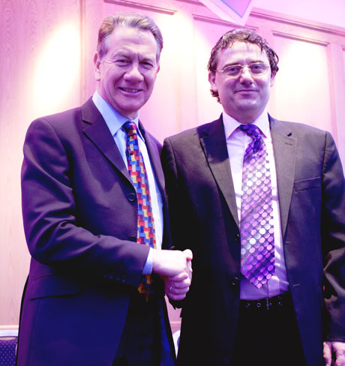
Who Do We Work With?
In 2013-2014, we have worked with/ will work with broadcaster Michael Portillo, TV celebrity Johnny Ball and teaching experts Geoff Petty, Bradley Lightbody and Professor Frank Coffield.

Slide 4
Why Teaching?
“I think the teaching profession contributes more to the future of our society than any other single profession”.
John Wooden, Sports Coach and Speaker
“It is the supreme art of the teacher to awaken joy in creative expression and knowledge.”
Albert Einstein

Slide 5
What is Further Education?
working with learners aged 16 and upwards
and occasionally…
working with 14-16 year olds

Slide 6
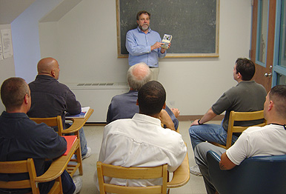
Further Education is very diverse…
Colleges & Adult Learning
Private Training
Language Schools
Prison Education
Specialist Support
Independent Schools

Slide 7
What You Can Earn…
A further education teacher can earn between £18,000 and £39,000, depending on the college they join
A further education manager can earn between £36,000 and £55,000 depending on their role and college
Many of the top College Principals earn over £100,000!

Slide 8
Starting Your Teaching Career…
It is very difficult in today’s job market to get a teaching job without a teaching qualification
Most unqualified applicants do not make the interview stage!

Slide 9
It is our belief that we can teach anyone to become a great teacher!
We will give you the confidence, skills and knowledge to begin your teaching journey…

Slide 10
What is the Teaching Award?
The Award in Teaching in the Lifelong Learning Sector is a nationally recognised qualification
There are no formal entry requirements
It takes six weeks to achieve
You are assessed by coursework and a 15 minute microteach
Your certificate is awarded by the NCFE Awarding Body that accredits our centre

Slide 11
What You Will Cover
Supporting students with individual needs
Designing and using a range of interesting teaching and learning materials
Lesson plans and schemes of work
Principles and theories of learning
Different forms of assessment
Communication and presentation skills
Creating a warm, respectful learning climate

Slide 12
How Your Study is Planned
6 lessons to complete the course
Tuesdays, 09.30-13.00, with 20 minutes refreshment break
First session develops your confidence in speaking and presentation
Teaching methods are based around discussions, projects and group activities
Assessment tasks and a 15 minute microteach to the rest of the class
You are expected to put in 4.5 hours of extra study per week

Slide 13
Structure of the Qualification
You must achieve 12 credits to gain the qualification. These 12 credits are drawn from 3 groups of units.
3 credits from Group 1 – Mandatory
6 credits from Group 2 – 2 x options are selected
3 credits from Group 3 – 1 x option is selected

Slide 14
How You Are Assessed…
Unit 1 – Roles, responsibilities and relationships in lifelong learning
You will need to:
Produce a job role for a specific teaching position using the national teaching standards
A reflective journal showing how your current and previous experiences might develop this role profile

Slide 15
How You Are Assessed…
Unit 2 – Understanding inclusive learning and teaching in lifelong learning
You will need to:
Write a report examining the strengths and weaknesses of different teaching methods
Develop a learning resource that is appropriate to a range of different learners
Produce a reflective learning journal that explains how to support learner’s language, literacy and numeracy skills in your teaching

Slide 16
How You Are Assessed…
Unit 3 – Using inclusive learning and teaching approaches in lifelong learning
You will need to:
Complete a 15 minute microteach to your peer group showing evidence of appropriate planning, communication methods and assessment.
Provide feedback to other learners who are completing microteaches

Slide 17
How You Are Assessed…
Unit 4 – Understanding the principles and practices of assessment
You will need to:
Create a glossary of key assessment terms
Produce a table of assessment methods summarising their strengths and weaknesses
Devise a lesson plan consisting of learning outcomes, teaching methods and assessment methods and provide a rationale for its design
Choose one assessment method and write a short report explaining its purpose, validity, and appropriateness to a selected group of learners and how it can be used to provide feedback on a learner’s progress and improve their learning

Slide 18
Further Reading
We strongly recommend these two textbooks:
Outstanding Teaching and Learning 14-19, Bradley Lightbody, 2012, 2nd Ed.
Teaching Today, Geoff Petty, 2009, 4th Ed.

Slide 19
How to Enrol
Complete an enrolment form today and hand it in to us – you will be reserved a place automatically
OR, Download an enrolment form our website at www.newbubbles.com and send it in to: 47 Chichester Road, North End, Portsmouth. PO2 0AB.
Pick up a voucher - Pay within 7 days – via cheque – and you will get a £30.00 discount
Pick up a voucher for a friend and enrol together

Slide 20
Claiming our £30.00 Discount
The £30.00 discount is on offer today only (19 Nov 2013)
It applies only to applicants who will be paying their own course fees
We will issue you with a voucher JP1050 and you have 7 days to send us a cheque for the outstanding amount £279.50
To spread the cost, you can pay in 2 instalments by sending 2 post-dated cheques

Slide 21
Financial Help
There are three ways to pay for this course:
You pay your own fees
Your employer pays your fees
You apply for a 24+ Learning Loan and use this to pay your fees (you don’t pay anything back till 2016)

Slide 22
Getting a 24+ Loan?
You have to be 24+ to qualify
Must be a UK resident
Your course fees have to cost at least £300.00
We e-mail you a “Learning and funding information letter” which contains all the relevant information for your application
You apply online at https://www.gov.uk/advanced-learning-loans/how-to-claim
You receive a letter from Student Finance England within 2 weeks to confirm that your application is successful
The government pays your course fees directly to us
Nothing paid by you till 2016. Nothing ever paid if you earn less than £21,000

Slide 23
Any Questions?
We will be delighted to answer any questions you may have about the course and enrolment process.
We look forward to assisting you with your new career

